Slide 1

CS554 Final Project
Group member
Zehui Zhao Huijun Sun Yunxiang Fu Shiwei Ding

Slide 2
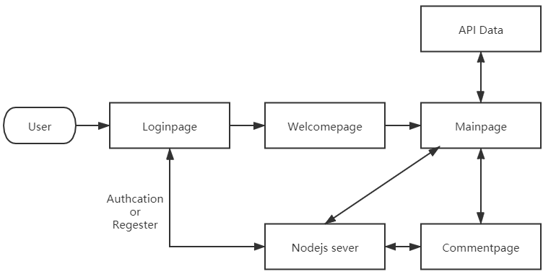
Design frame

Slide 3
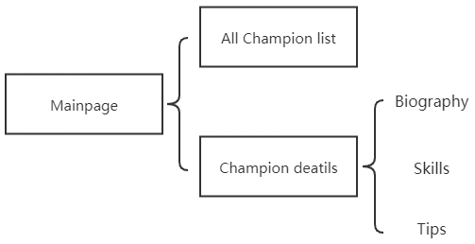
Main Page Block

Slide 4

Using Technique
Sever: node.js + express sever, mongoDB database, redis
Front - frame: React App + typescript
Animation transformation: GSap (GreenSock Animation Platform)
Extra – technique: Nodemailer

Slide 5

Project presentation

Slide 6

Login Page
Login page two part:
Left sign up, require username, email and password
Right sign in, require username and password
Sign up success get into welcome page, failed will see register fail alert, stop here
Sign in success get into welcome page, failed will see login failed alert, stop here

Slide 7
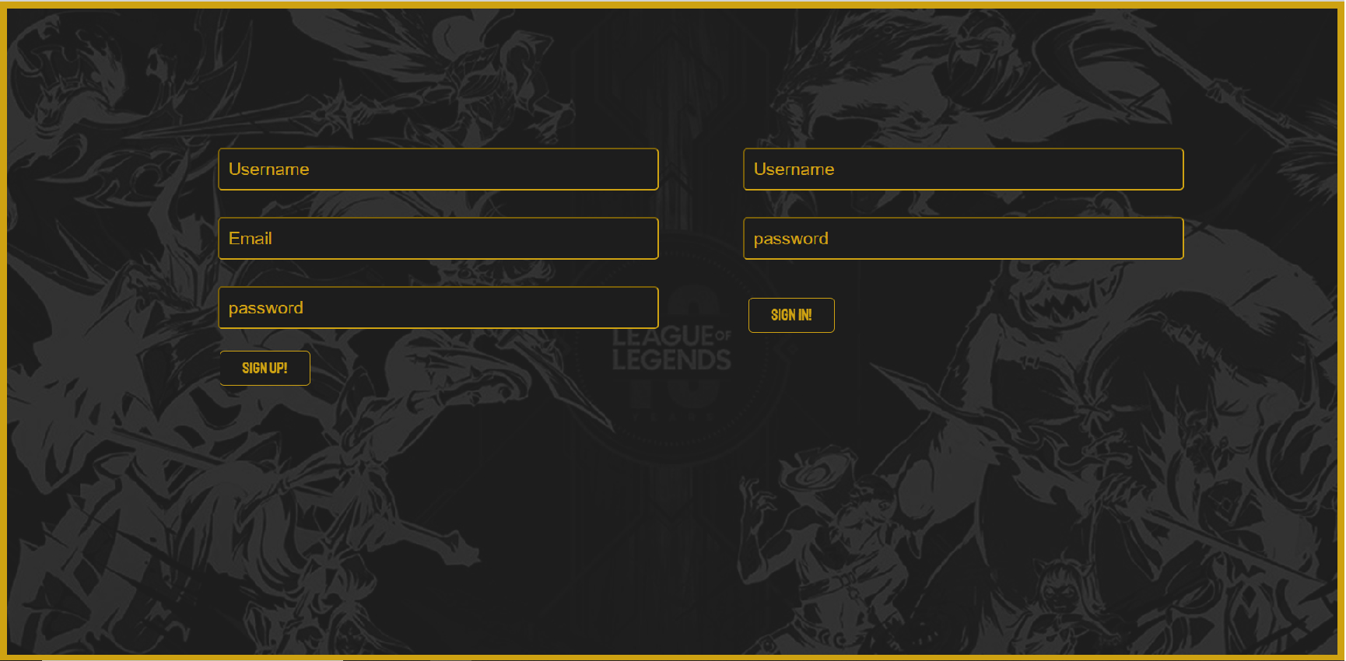
Login Page show

Slide 8
Main Page
Main Page two part:
Top: Main header, place search box, user reviews and user comments button
Bottom: Main container, place each Champion which fetch from API, link to
each Champion individual pages.

Slide 9
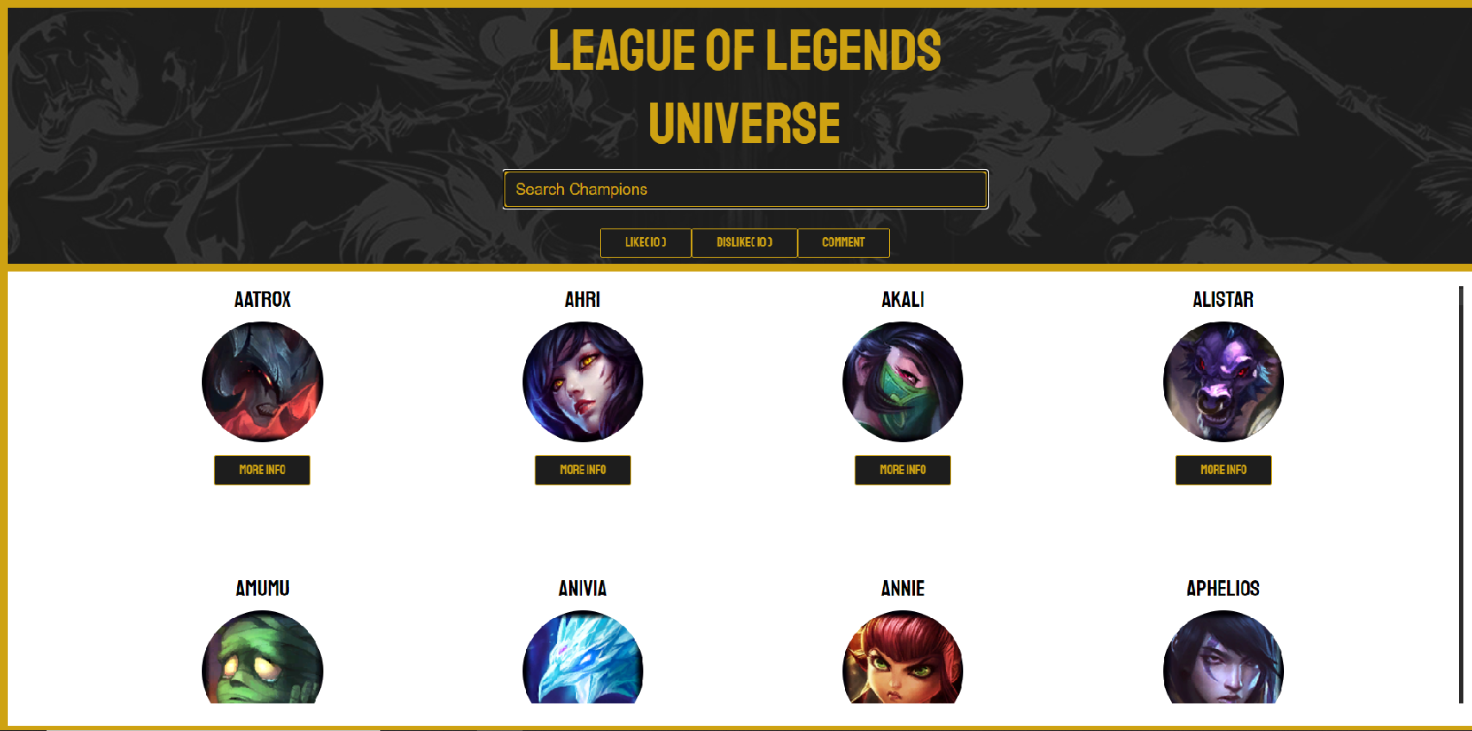
Main Page show

Slide 10
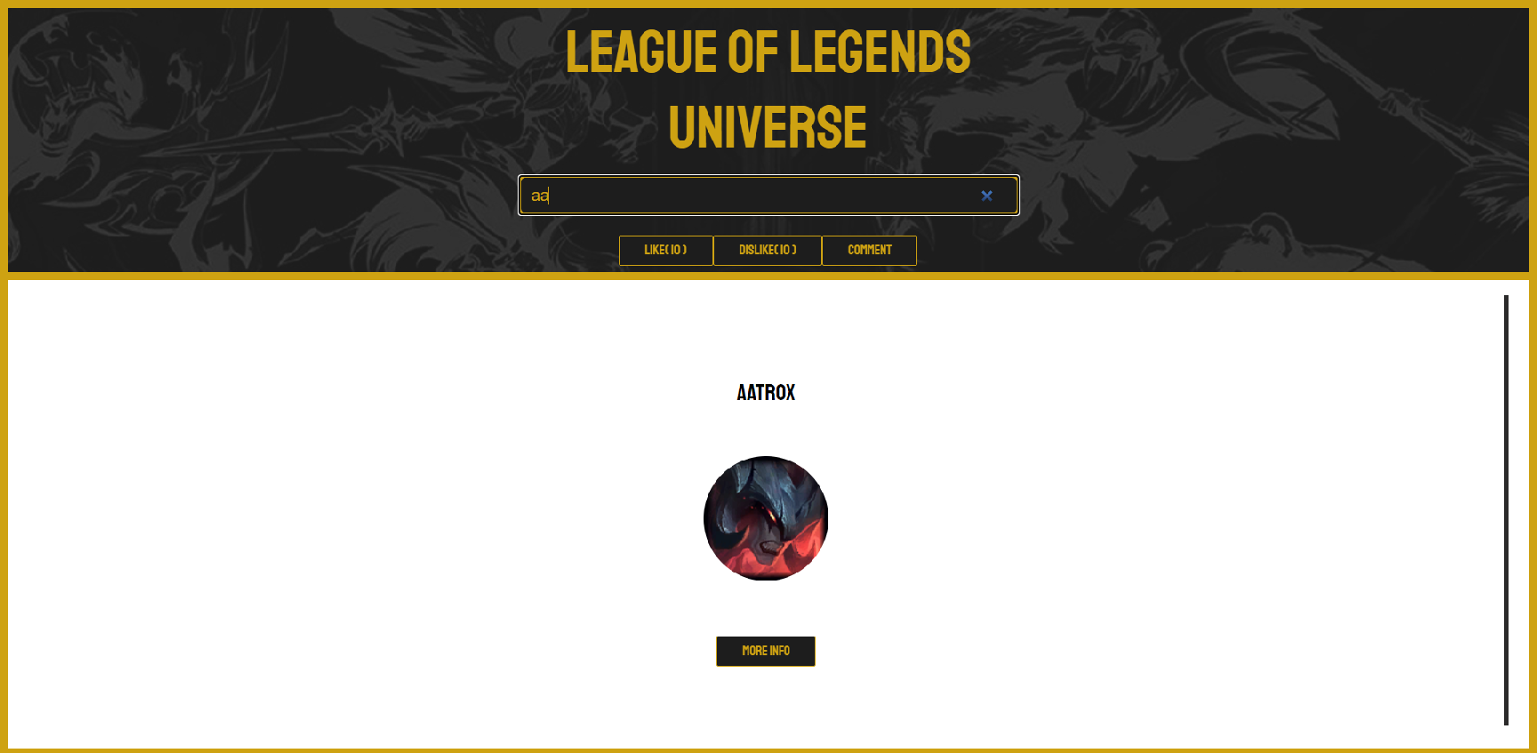
Search Box show

Slide 11
Champion Page
Champion pages are not use independent router, we use Gsap to hidden the main page, show the champion pages for each Champion.
Details for a Champion is hidden in the bottom, click the arrow button to see it. This part also use Gsap to control it.

Slide 12
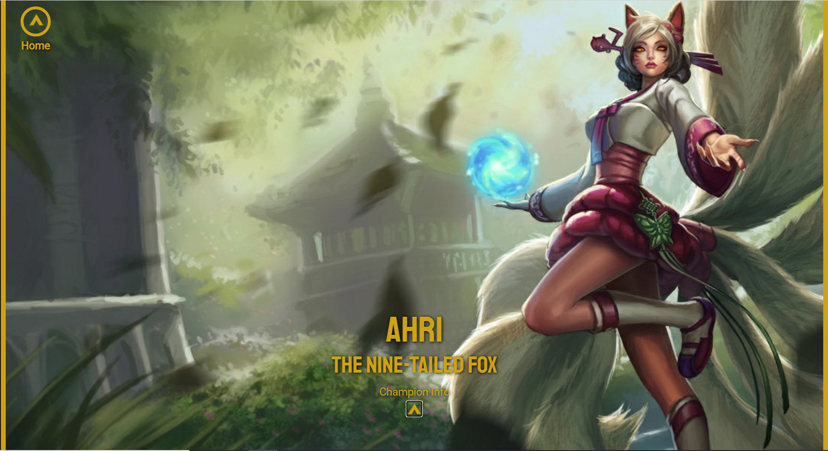
Champion Page show

Slide 13
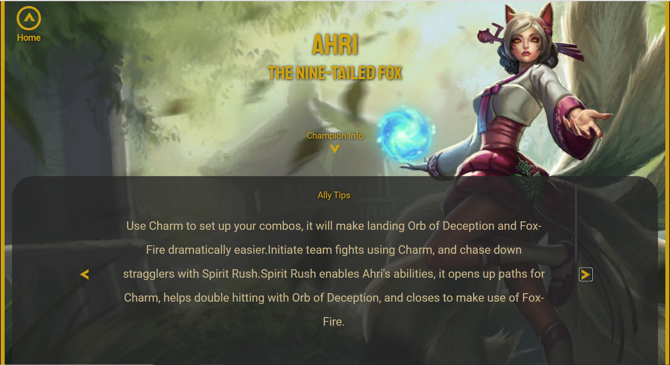
Champion Page show

Slide 14
Comment Page
Comment Page provide user to send their comment to our website, the title and context of the comment cannot be null
User also can see all comments in previous, click the “SHOW PREVIOUS COMMENT” button to show it.

Slide 15
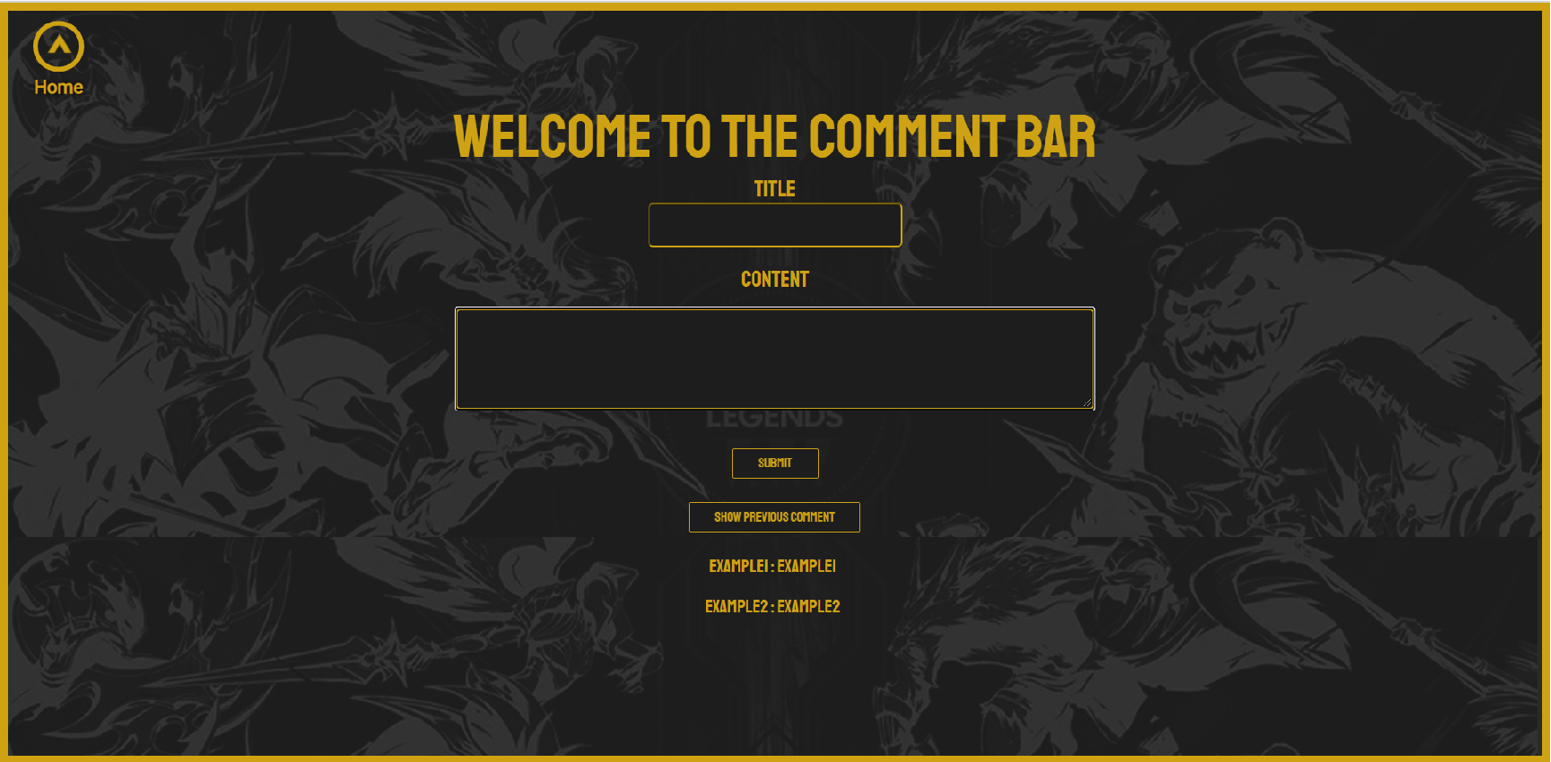
Comment Page

